Slide 1

Introduction to Python
Python Basics for Data Science
Onyero Walter Ofuzim

Slide 2

Course Overview
Course objectives:
Learn Python fundamentals
Programming concepts.
Prerequisites: None

Slide 3
Introduction to Python, Why Python
Python is a versatile, high-level programming language.
Why Python: Versatility, Ease of Learning, Large and Active Community, Automation, High Demand in the Job Market.
Python's simplicity and readability make it ideal for beginners.

Slide 4
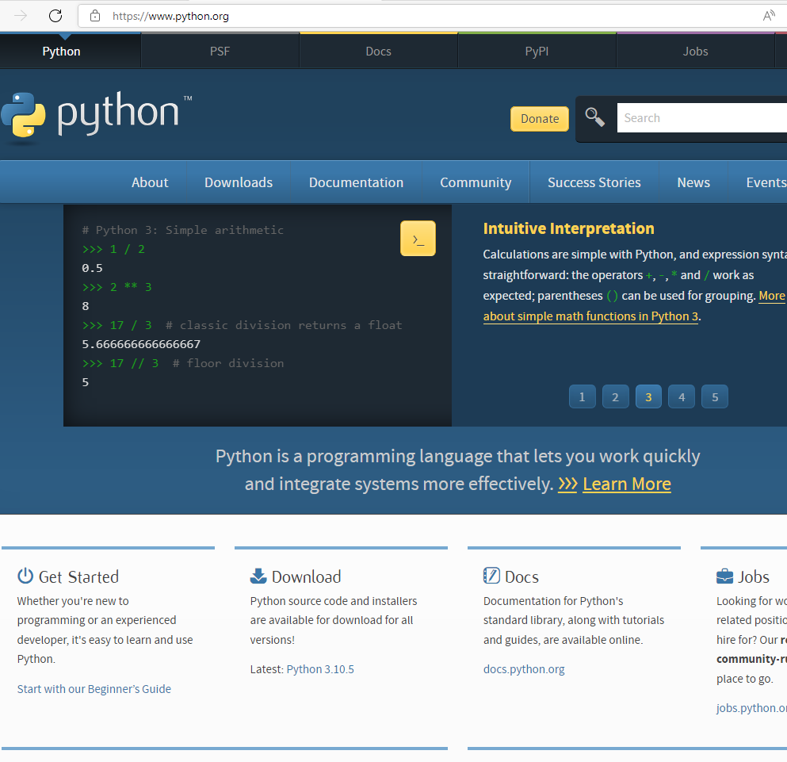
Installing Python
Step-by-step guide to installing Python:
Visit python.org.
Download the latest Python 3.x version.
Follow installation instructions for your operating system.

Slide 5
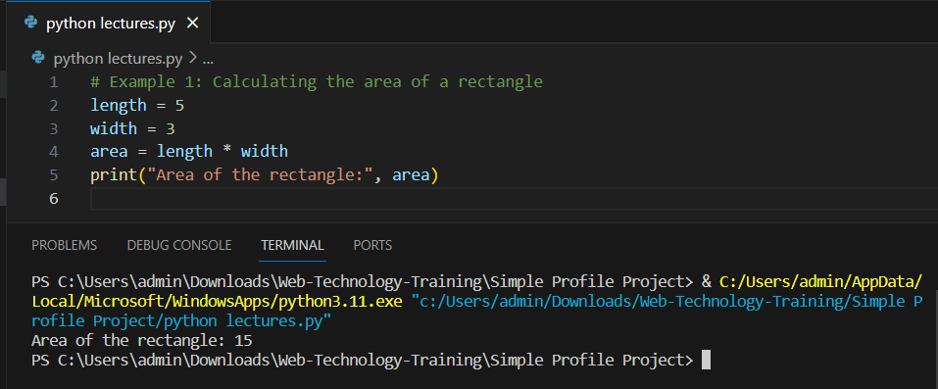
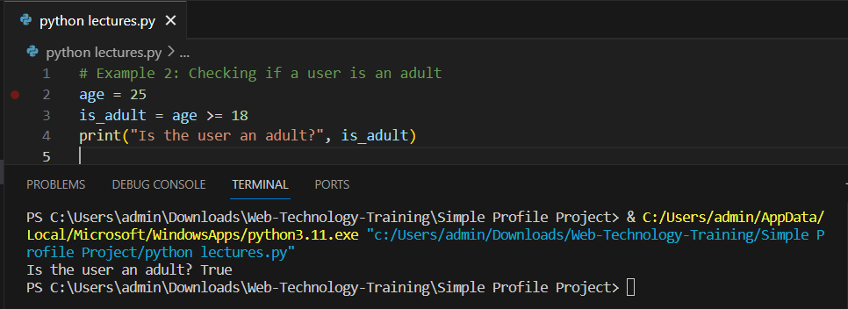
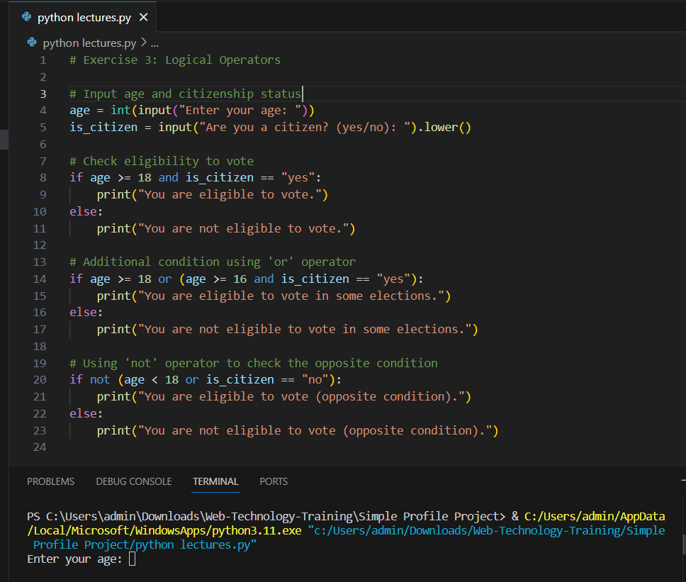
Python Basics (Variables, Data Types, Math, and Logical Operators)
Print function. Print()
Variables: - Variables are basically to store data values in the memory. (age = 100)
Data types: int, float, str, bool.
Mathematical operations: +, -, *, /, %.
Logical operators: and, or & not.

Slide 6
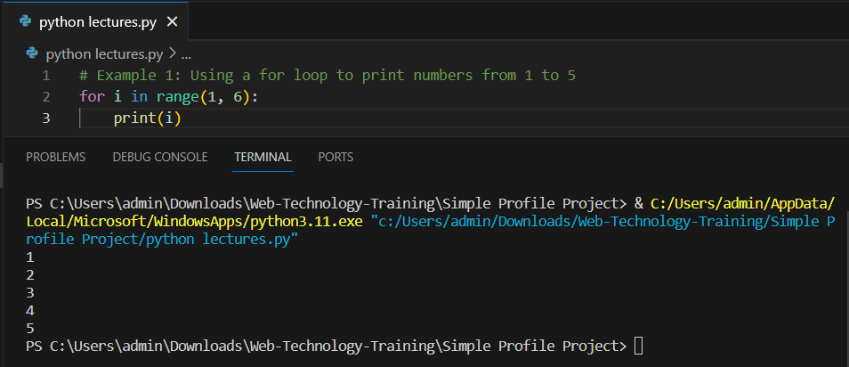
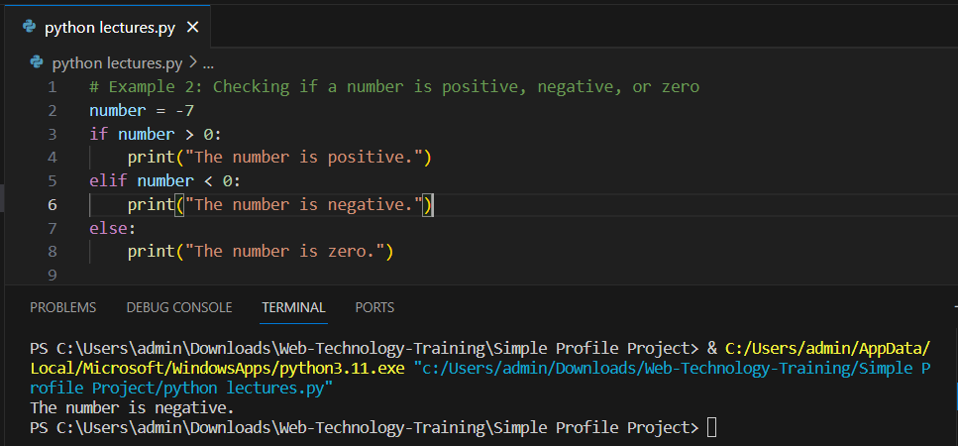
Loops and Conditionals
for and while loops: Iterate over sequences.
if, elif, and else statements: Control program flow.
For loops are used to iterate over a sequence (e.g., lists, tuples, strings).
While loops are used when you need to repeatedly execute a block of code if a condition is true.

Slide 7
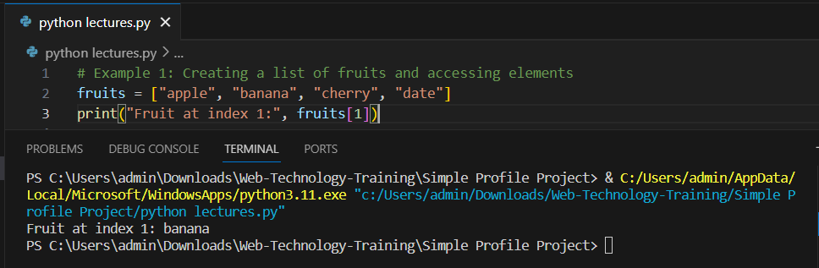
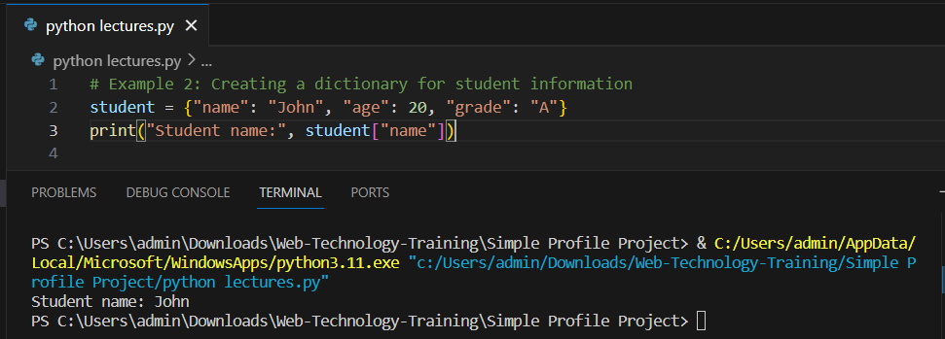
Data Structures
Data structures in Python are used to store and organize data efficiently. They are fundamental for various programming tasks and are an essential part of Python programming. Examples List, Tuples, Dictionaries, Set.
Lists: - Ordered collections of items. - They are mutable. - [ ]. - Common operations include appending, indexing, and slicing.
Tuples: - Like lists but are immutable.- ( ). - They are often used for storing related pieces of data together.
Dictionaries: - Unordered collections of key-value pairs. - Keys are unique and immutable. - Access values by their keys.- { }.
Sets**: - Unordered collections of unique elements. - { } or the set() constructor.

Slide 8
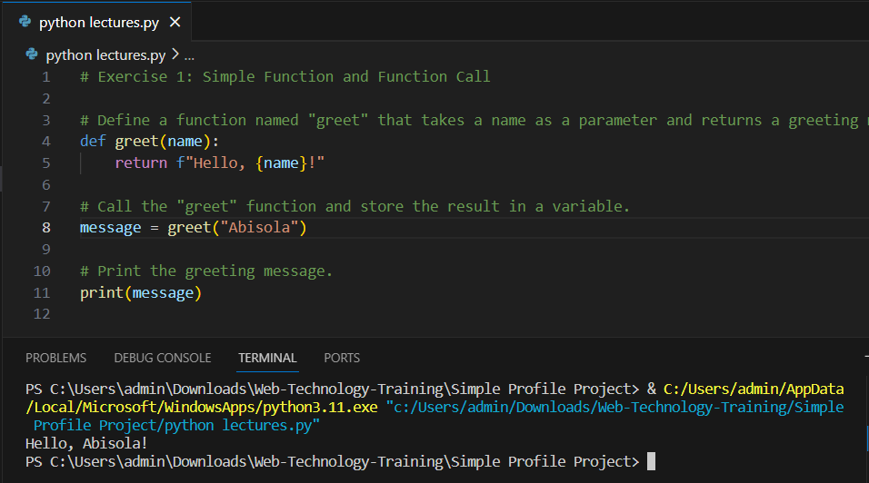
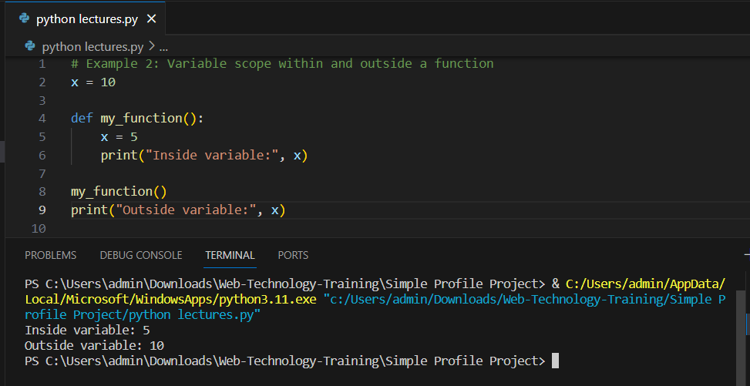
Functions and Variable Scope
Functions: Allows you to break down your code into modular (chunks) and reusable blocks.
def and call functions.
Local vs. global variable scope.

Slide 9
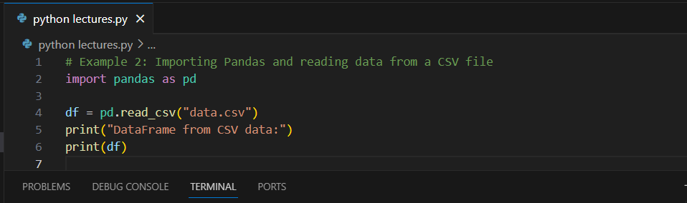
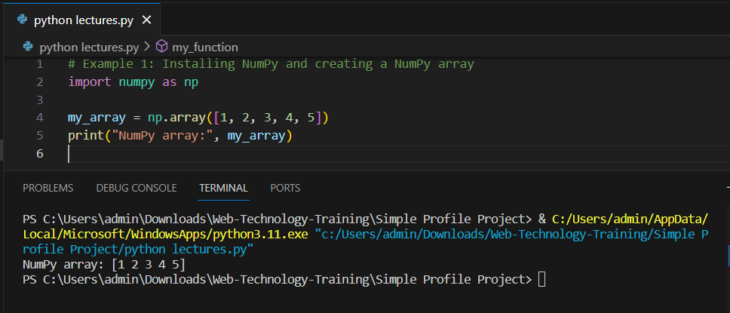
Packages
Packages (also known as libraries or modules) are collections of pre-written Python code that extend the language's functionality.
Examples: NumPy, Pandas, Matplotlib.

Slide 10
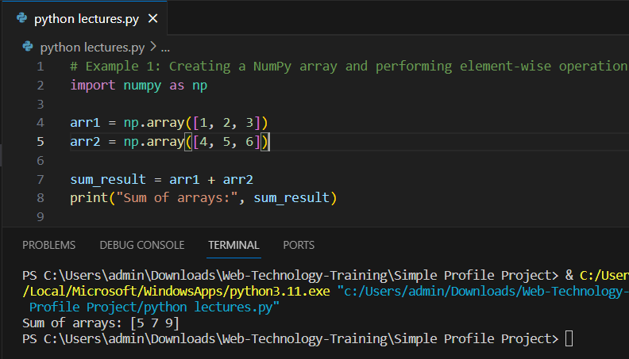
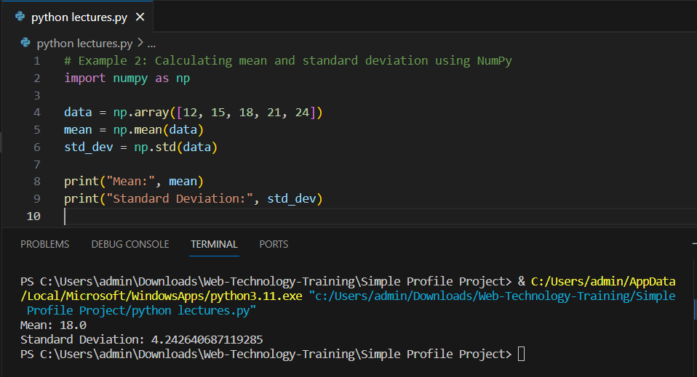
NumPy
NumPy (Numerical Python) is a fundamental package for scientific computing in Python.
It provides support for large, multi-dimensional arrays and matrices, as well as a variety of mathematical functions to operate on these arrays.
NumPy is essential for tasks like numerical simulations, data analysis, and machine learning.

Slide 11
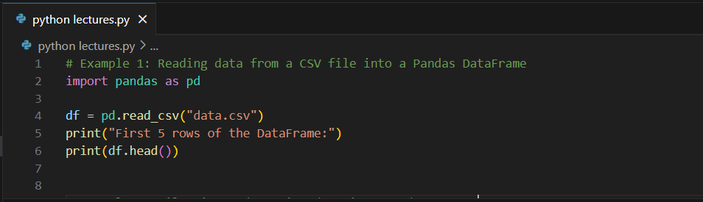
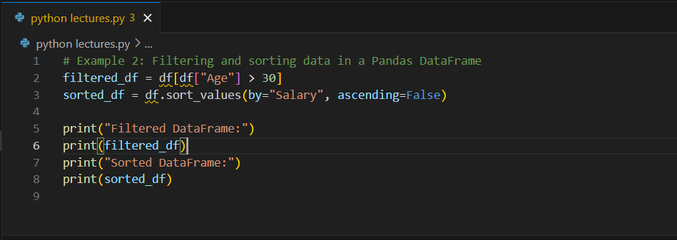
Pandas for Data Analysis
Pandas is a powerful data manipulation and analysis library for Python.
It introduces two primary data structures: Series (1D) and DataFrame (2D), which make handling structured data easy and efficient.
Pandas is commonly used for data cleaning, transformation, and exploration.

Slide 12
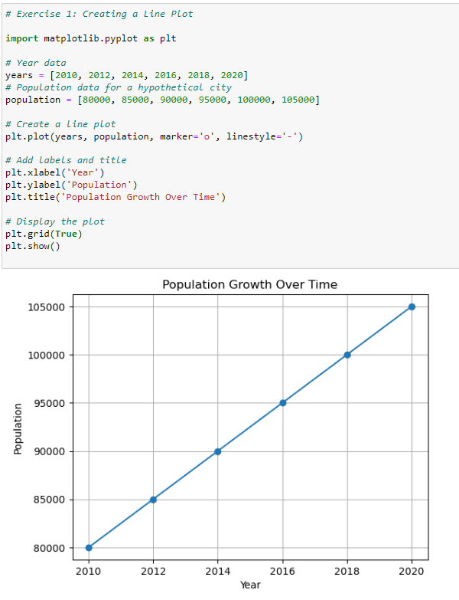
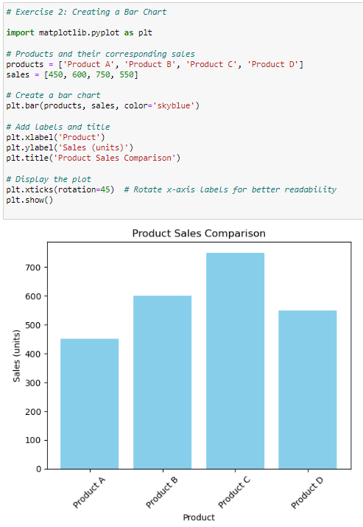
Matplotlib
Matplotlib is a popular library for creating static, animated, or interactive visualizations in Python.
It offers various plot types, such as line plots, scatter plots, bar charts, histograms, and more.
Matplotlib is often used in data analysis and scientific plotting.

Slide 13
Additional Resources
Additional Packages includes: Scikit-learn, TensorFlow and PyTorch, Requests, Beautiful Soup, SQLAlchemy, OpenCV, Natural Language Toolkit (NLTK)
Recommended Books: "Python Crash Course" by Eric Matthes, "Automate the Boring Stuff with Python" by Al Sweigart.
Online Tutorials: FreeCodeCamp, Coursera, edX.
Python Documentation: Exploring Python's official documentation at python.org.

Slide 14
Practice and Exercises
Exercise 1: Calculate the sum of numbers from 1 to 10 using a for loop.
Exercise 2: Create a function to calculate the factorial of a given number.
Exercise 3: Read a CSV file using Pandas, display the first 5 rows, and plot a bar chart.

Slide 15
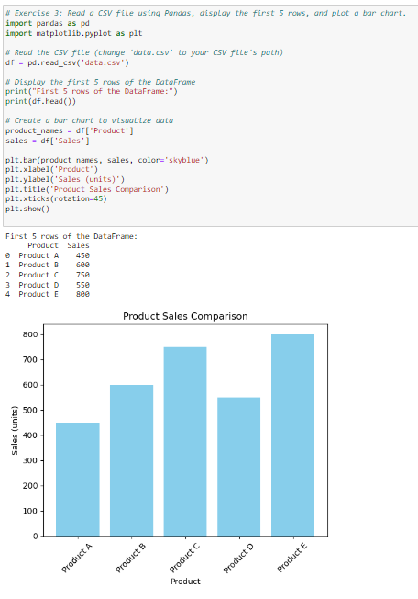
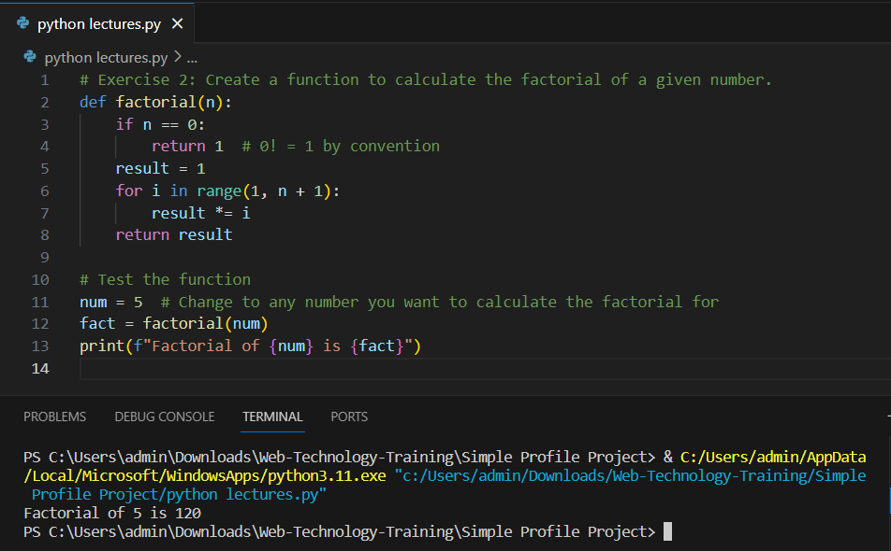
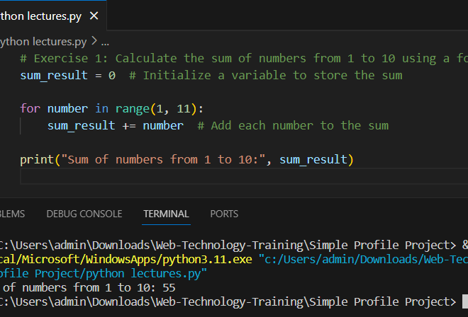
Solution

Slide 16
Thank You!!

